Slide 1


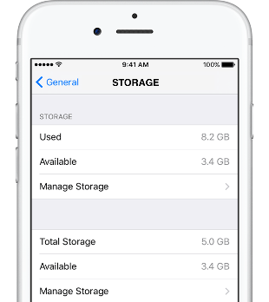
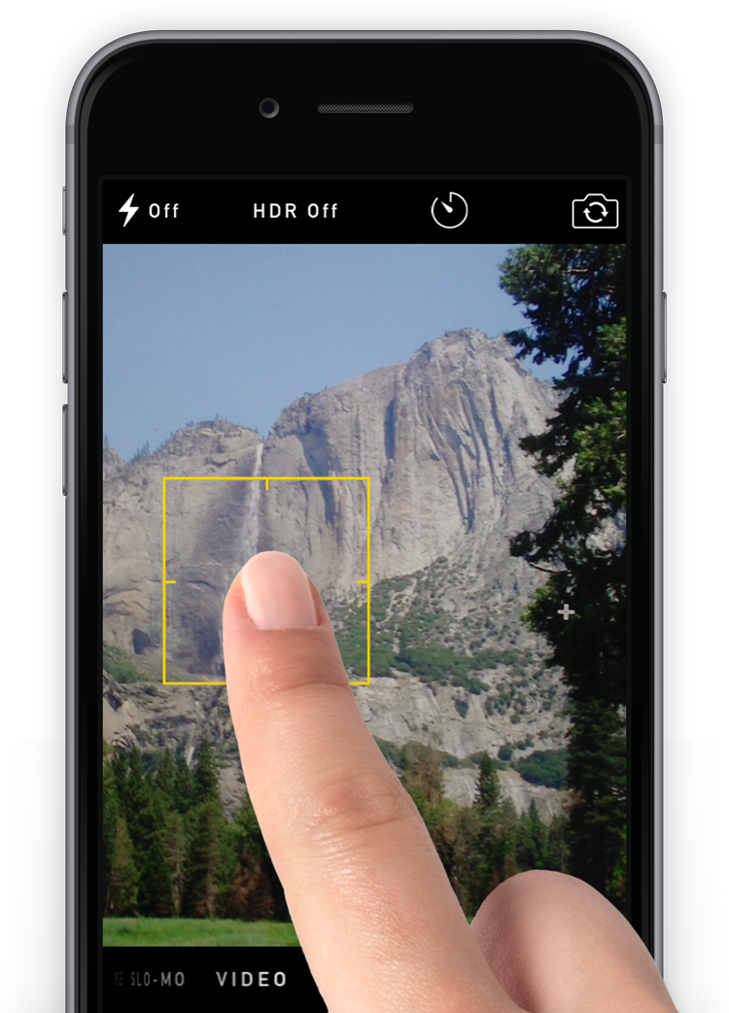
Saliency, Anchors & Frames:
A Multicomponent Damages Experiment
Professor Bernard Chao & Roderick O’Dorisio J.D. ‘18
Abstract
Hypotheses
Saliency & Anchoring
Different Jury Verdict Forms
Modern technology products contain thousands, sometimes hundreds of thousands, of different features. Nonetheless, when electronic manufacturers are sued for patent infringement, these suits typically accuse only one feature, or in more complex suits, a handful of features. But damages verdicts often do not reflect the relatively small contribution an individual patent makes to an infringing product. One study observed that verdicts in these types of cases average 9.98% of the price of the entire product. While both the courts and commentators have blamed the law of patent damages, no one has considered whether cognitive biases may cause these outsized damages awards. Relying on decision-making concepts from other contexts, the authors hypothesize that two biases, namely, a saliency bias and anchoring, may be at work in a patent trial. Since the infringing feature is the most salient feature in a patent trial (i.e. the focus of the trial), jurors may tend to overvalue that feature. Moreover, a patentee’s irrationally high damages demand, may “anchor” the juries in that number.
We conducted an online 3x3x2 between-subjects experiment to test whether these biases exist and if so, whether particular debiasing techniques may reduce these biases. In eighteen different scenarios, mock jurors were asked to assess damages for different smartphone features. The three manipulations involved: 1) rotating three features so that they were either the feature-in-suit or one of the other features defendant identified as contributing to the smartphone’s overall value; 2) changing the jury verdict form so that mock jurors had to evaluate both the feature-in-suit and other features together; and 3) having the defendant explicitly call out the plaintiff for anchoring the jury in an irrationally high number.
The results suggest that the two cognitive biases were at play when juries assessed damages for two tested features (camera resolution and enhanced security), but not a third (amount of storage). That may be because the value of increased storage was familiar to mock jurors while the values of the other two features were not. Modifying the jury verdict form reduced, but did not eliminate the primary effect of the saliency bias, while the defendant’s tactic of de-biasing the jury did not significantly reduce damages. In addition, qualitative comments suggested that some mock jurors resisted the jury instructions designed to compensate plaintiffs for the missing feature and instead assessed damages to punish the defendant
Saliency bias may cause juries to overvalue an infringing feature. Because the entire lawsuit is about the feature in suit, jurors may overestimate that feature’s value.
Anchoring may cause juries to overvalue an infringing feature. Plaintiff’s damages request may unduly influence the award.
Frames: Requiring mock jurors to assess multiple features simultaneously would reduce any saliency effect.
Exposing the Anchor: Mock jurors would be less susceptive to an anchor if they were expressly told about that bias.
Saliency Bias: Two features were valued higher when at-issue than when not at-issue
Frames: Valuing Multiple Features Together Reduced Damages Modestly
(Only significant Independent vs. Together5+Together8)
 | Independent Avg. Damages (Traditional) (n) | Together5 Avg. Damages (n) | Together8 Avg. Damages (n)
Camera | $68.25 (108) | $66.52 (106) | $62.65 (97)
Storage | $61.79 (119) | $56.96 (95) | $53.15 (85)
Security | $46.95 (131) | $39.15 (126) | $44.34 (109)
Exposing the Anchor
Experiment
Exposing the Anchor Had No Effect
Respondents: Online mTurk population, N=973,
representative on gender and income, but more liberal, younger, more educated and less diverse than U.S. population.
Basic Case – Product Misrepresentation Case. Plaintiff and defendant argue over value of missing feature. Defendant points to the value of other features NOT at issue to make argument.
Manipulations: 3x3x2 investigative actions, including:
Changing Feature rotating between plaintiff and defendant’s case(x3)
Camera, 12 MegaPixel vs 8 Megapixel
Storage, 128 Gig vs 96 Gig
Security, 6 Digit Code vs. 4 Digit Code
Traditional jury verdict form vs simultaneous valuations (x3)
Defendant expressly exposes anchor (x2)
 | Control Average (n) | Debias Anchor Average (n) | p-value | 95% Confidence Intervals
Camera | $66.00 (159) | $65.78 (149) | 0.96 | $-7.71 to $8.14
Storage | $57.88 (152) | $57.72 (148) | 0.97 | $-9.60 to $9.92
Security | $46.03 (188) | $40.80 (178) | 0.22 | $-3.18 to $13.66
Some jurors try to follow instructions
Juror 73 | Memory is one of the most expensive upgrades in new phones, market rate is about $100 to go from 64 to 128 GB. So going from 96 to 128 should be about $50.
Juror 704 | The difference in price, according to the plaintiff, between a 4-character passcode Ultra smartphone and a 6-character passcode Ultra smartphone is $99. That means plaintiffs should receive the difference in the price between what they paid for what they were getting and what they actually got.
Some mock jurors use damages to punish
Juror 237 | I believe that the damages sustained by the plaintiff are negligible, and that even $5 was perhaps being a bit too generous. There should, however, be some compensation for a falsely advertised feature than cannot be changed.
Juror 641 | Yes, the smartphone has other important features but they intended to mislabel the boxes to mislead their customers, they are untrustworthy and should be punished.
 | Plaintiff Average (n) | Defendant Average (n) | p-value (t-test) | Effect Size 95% Confidence Intervals
Camera | $65.89 (308) | $56.95 (665) | p < 0.001 | -$3.49 -$14.40
Storage | $57.80 (299) | $60.84 (674) | p = 0.34 | $9.28 -$3.19
Security | $43.49 (366) | $23.46 (607) | p < 1.5e-15 | -$15.23 (5%) -$24.81 (95%)
Other jurors appeared to simply split the difference
Jury 692 | I felt that $99 was too high so I just split the amount. I feel the customer's could have returned the phone.
Juror 832 | . . . . What the defendant suggests is an appropriate reparation (appx $4 and some change) does not seem adequate given the significant different in storage that was promised . . .The plaintiff’s demand for $99 also felt excessive because, again, in the actual sense -- they got what they paid for. But I also understand they may have chosen a different product if they realized the product was not what it seemed, so I empathize with them on that point. Given that there is some merit to both arguments, I decided to split down the middle (roughly) at $40.
Dependent Variables:
Damages of Feature in Suit
Value of other Features Discussed by Defendant

