Slide 1
ICO Landscape

Slide 2
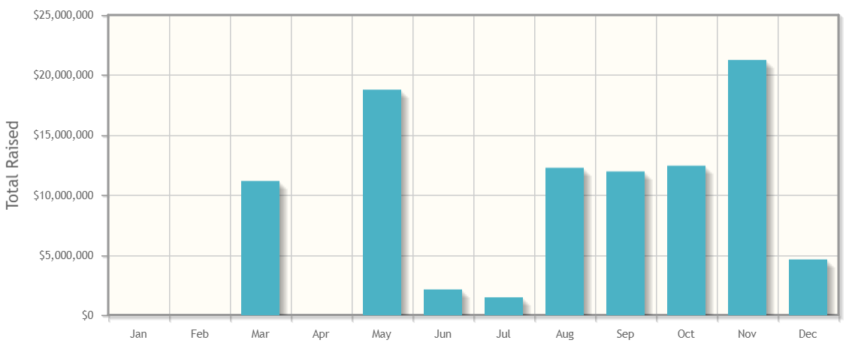
ICO Funding
strictly confidential
2016
$256M in 2016 ($500M raised in traditional VC funding)
43 ICO’s
Average size: $6M
2
Source: CoinSchedule, Tokendata.io

Slide 3
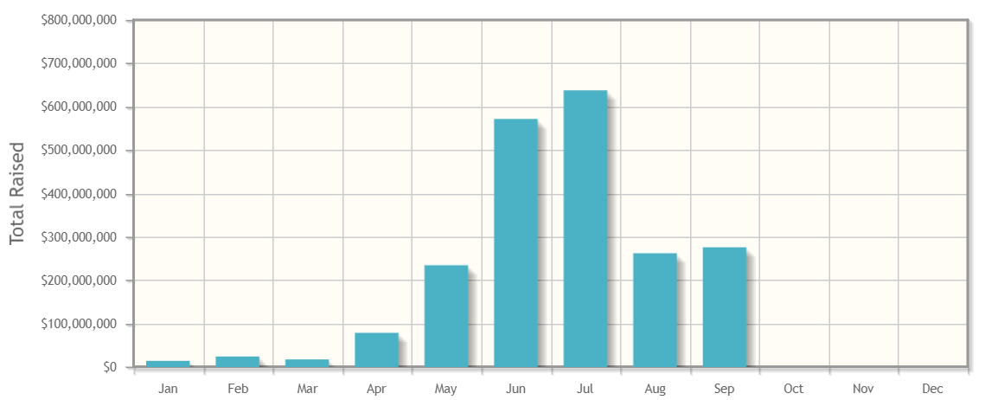
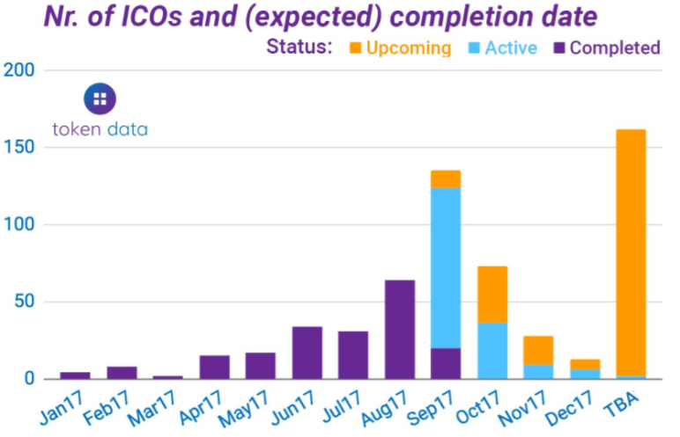
ICO Funding
strictly confidential
2017
$1.5B raised through ICO’s YTD
June-July was $1B+ of funding
57 ICO’s in the second week of Sept, a record
120+ ICO’s
Average size: $12M
2017 (est.)
2
Source: CoinSchedule, Tokendata.io

Slide 4
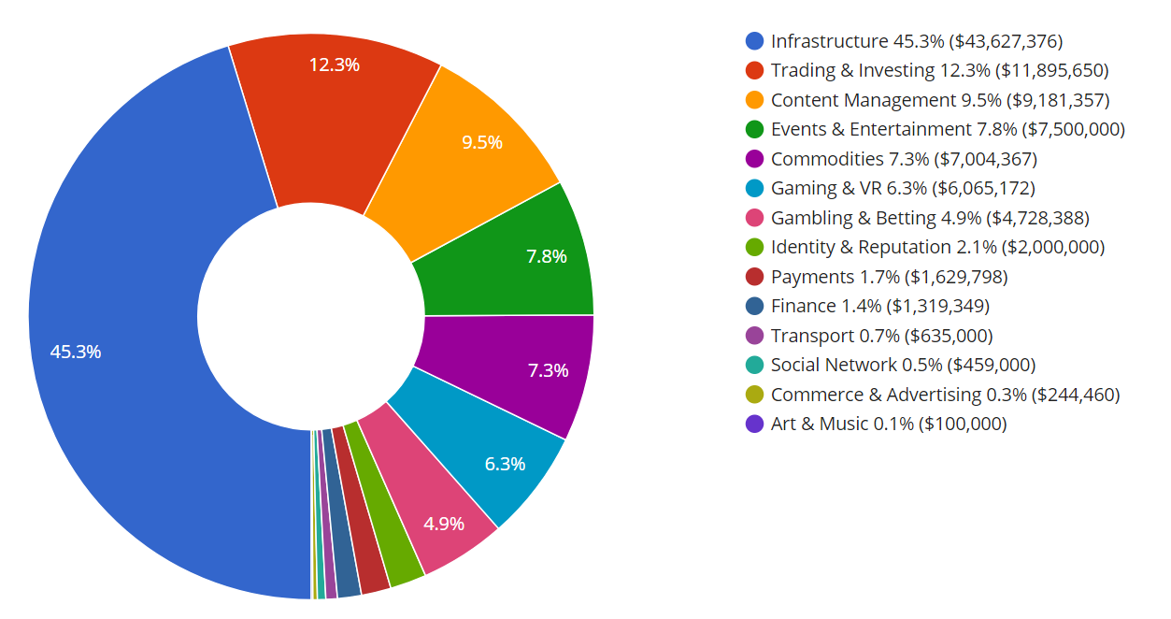
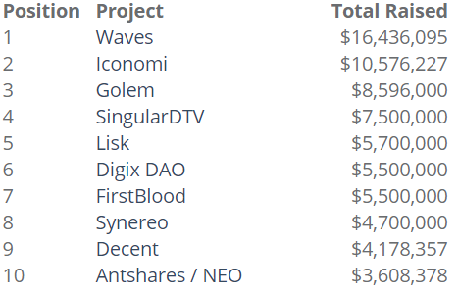
ICO Detail
strictly confidential
ICO Themes
Infrastructure the top application (45%)
Trading & Investing (12%)
Content Management (10%)
Events & Entertainment (8%)
2016
Top 10 ICO’s in
2016
2
Source: CoinSchedule

Slide 5
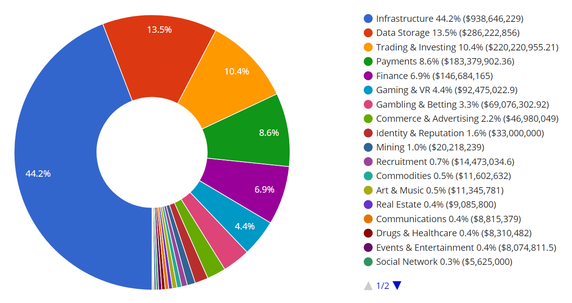
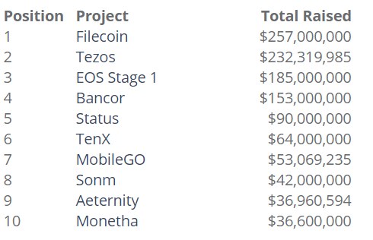
ICO Detail
strictly confidential
ICO Themes
Infrastructure remaining the top application (44%)
Data Storage (14%)
Trading & Investing (10%)
Payments (9%)
2017
Top 10 ICO’s in
2017
2
Source: CoinSchedule

Slide 6
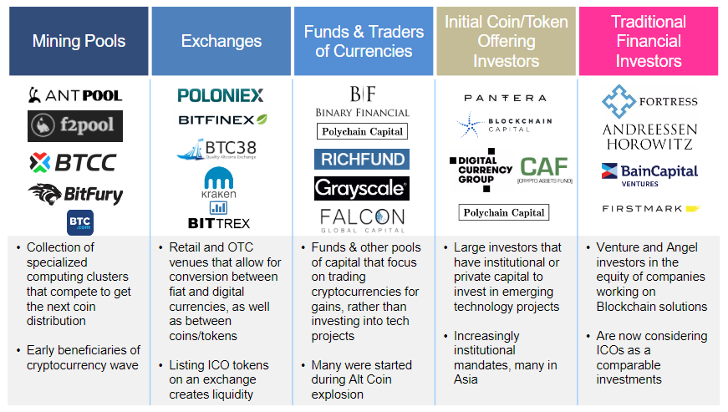
Sources of Capital
strictly confidential
2
Source: Autonomous NEXT

